Slide 1

Crowd counting using video analytics
Tools used:
Flask, YOLOv8, OpenCV, Firebase Authentication, Firebase Realtime Database, NumPy, Matplotlib, HTML, CSS, JavaScript
Mentor Name: Umme Asma
Batch -3 Details:
Start Date: 22-09-2025
End Date: Presented by:
Nihar kore

Slide 2
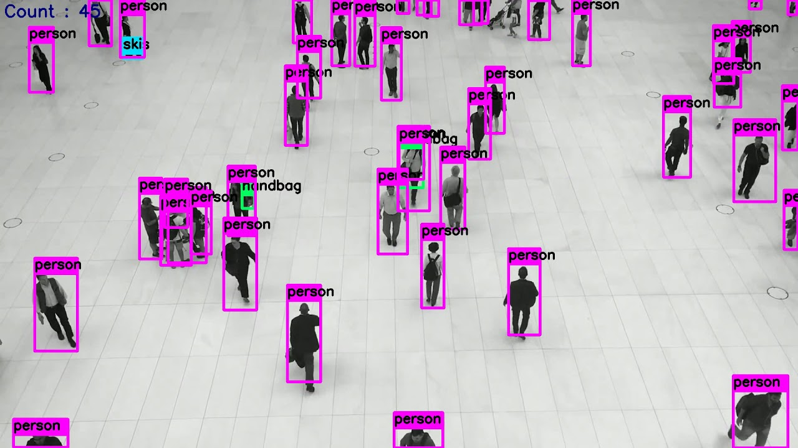
Agenda
• Introduction • Problem Statement • Objectives • System Architecture • Tools & Technologies • Implementation Details • Detection, Tracking & AOI Monitoring • Dashboard & Exportable Reports • Admin Panel • Output Screens • Steps to Operate website • Future Enhancements • Applications • Conclusion

Slide 3
introduction
This project focuses on automating real-time crowd counting and zone monitoring by using computer vision and deep learning. The system detects and tracks people from live camera feeds or uploaded videos using YOLOv8 and OpenCV, and displays real-time analytics through an interactive Flask dashboard.
Built with a secure role-based architecture using Firebase Authentication, the solution supports multiple cameras, customizable Areas of Interest (AOIs), density monitoring, alert thresholds, and historical data logging. The system improves safety, operational efficiency, and decision-making in dynamic public environments.

Slide 4
Problem statement
In crowded places such as malls, airports, events, and offices, it is difficult to manually monitor how many people are present in a specific zone. Traditional monitoring is often slow, unreliable, and prone to human error.
This project addresses these challenges by:
Automating real-time detection and counting of people in live camera feeds using YOLOv8.
Providing interactive dashboards with zone-based analytics and density monitoring.
Offering historical reports, alerts, and user-defined monitoring zones for improved crowd management.
The system ensures high accuracy, real-time responsiveness, and scalable monitoring across multiple areas.

Slide 5
objectives
• To automate real-time people counting using computer vision and deep learning. • To provide accurate detection, tracking, and zone-based monitoring through AOI selection. • To deliver real-time crowd density, alerts, and analytical visualizations. • To support multi-camera monitoring and role-based access through an admin/user system. • To generate exportable history logs for reporting and analysis. • To improve safety, decision-making, and operational efficiency in crowded areas.

Slide 6
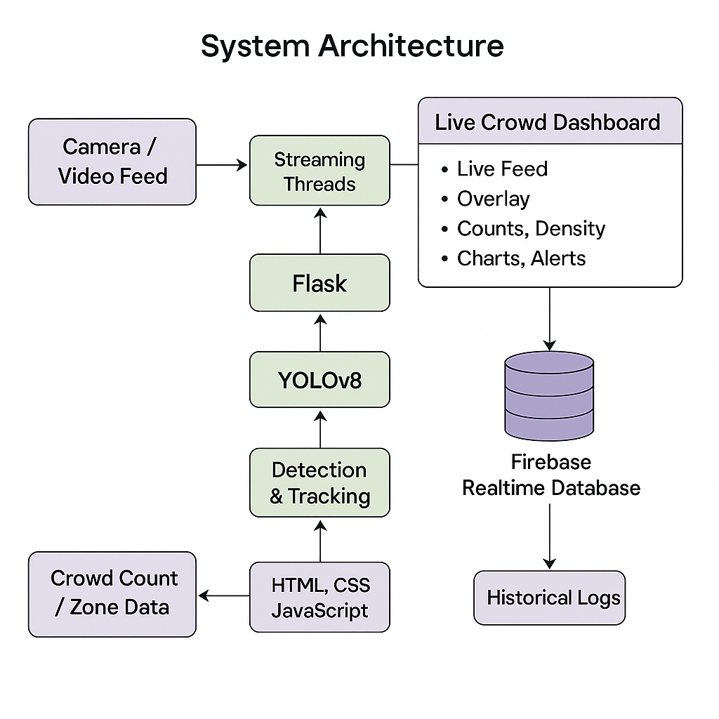
System architecture

Slide 7
Tools and technologies
• Flask – Backend framework for dashboard and APIs • YOLOv8 – Deep learning model for real-time person detection • OpenCV – Video processing and frame handling • Firebase Authentication – User login and secure access • Firebase Realtime Database – Storing logs, history, and camera configurations • NumPy – Data handling and distance calculations • Matplotlib – Charts for analytics and density visualization • HTML, CSS, JS – Frontend interface and live updates • JWT – Secure session management and role-based control

Slide 8
Implementation details
This system is implemented using multi-threaded video processing where each camera feed is handled independently. The YOLOv8 model detects people in real-time, while a custom tracking mechanism maintains unique IDs for each person across frames.
Administrators can upload videos, activate live camera feeds, define AOIs, set capacity thresholds, and manage user roles. The system logs live crowd counts to Firebase, enabling detailed history analysis and export options.

Slide 9
Detection and tracking
• YOLOv8 detects people with high accuracy in every frame. • A tracking algorithm assigns unique IDs and maintains consistency across frames. • AOI-based analytics allow users to define monitoring zones and count people only within selected regions. • The dashboard displays bounding boxes, person IDs, AOI boundaries, real-time counts, and threshold-based density alerts. • All detection data is stored securely for future analysis.

Slide 10
Dashboard and exportable reports
Module | Purpose | Key Features
Live Crowd Dashboard | Real-time display of people count and AOI-based zone analytics | • Live video feed (Webcam/Uploaded Video) • Bounding boxes + IDs • AOI-based inside count • Total count, threshold, and density % • Live charts (crowd trend & density donut)
Admin Panel | Manage camera streams, AOI zones, thresholds, and users | • Start/stop camera streams • Upload video sources • Draw & save AOI rectangles • Set capacity thresholds • View all user dashboards • Delete history logs

Slide 11
Dashboard and exportable reports
Module | Purpose | Key Features
CSV Reports (Logs/History) | Export complete zone-wise or global history | • Timestamped logs • Area, count, time data • Separate zone-wise export • Admin can export all user logs
Camera Configuration | Save and restore camera settings and thresholds | • Load saved configs • Store camera name, threshold • Admin-only access

Slide 12
Admin panel
The Admin Panel provides complete control over the system, including:
User Management: Create, edit, or remove users and assign roles (Admin/User).
Camera & Zone Setup: Add cameras, upload videos, define AOI (rectangular zones), and set capacity thresholds.
Alert Settings: Configure overcrowding limits and real-time alert rules.
Dashboard Access: View all cameras, counts, density levels, and analytics.
History & Logs: View, download, or delete historical crowd logs for any zone.
System Configuration: Manage preferences, security settings, and integration options.
These features help administrators monitor, configure, and manage the crowd-counting system efficiently.

Slide 13
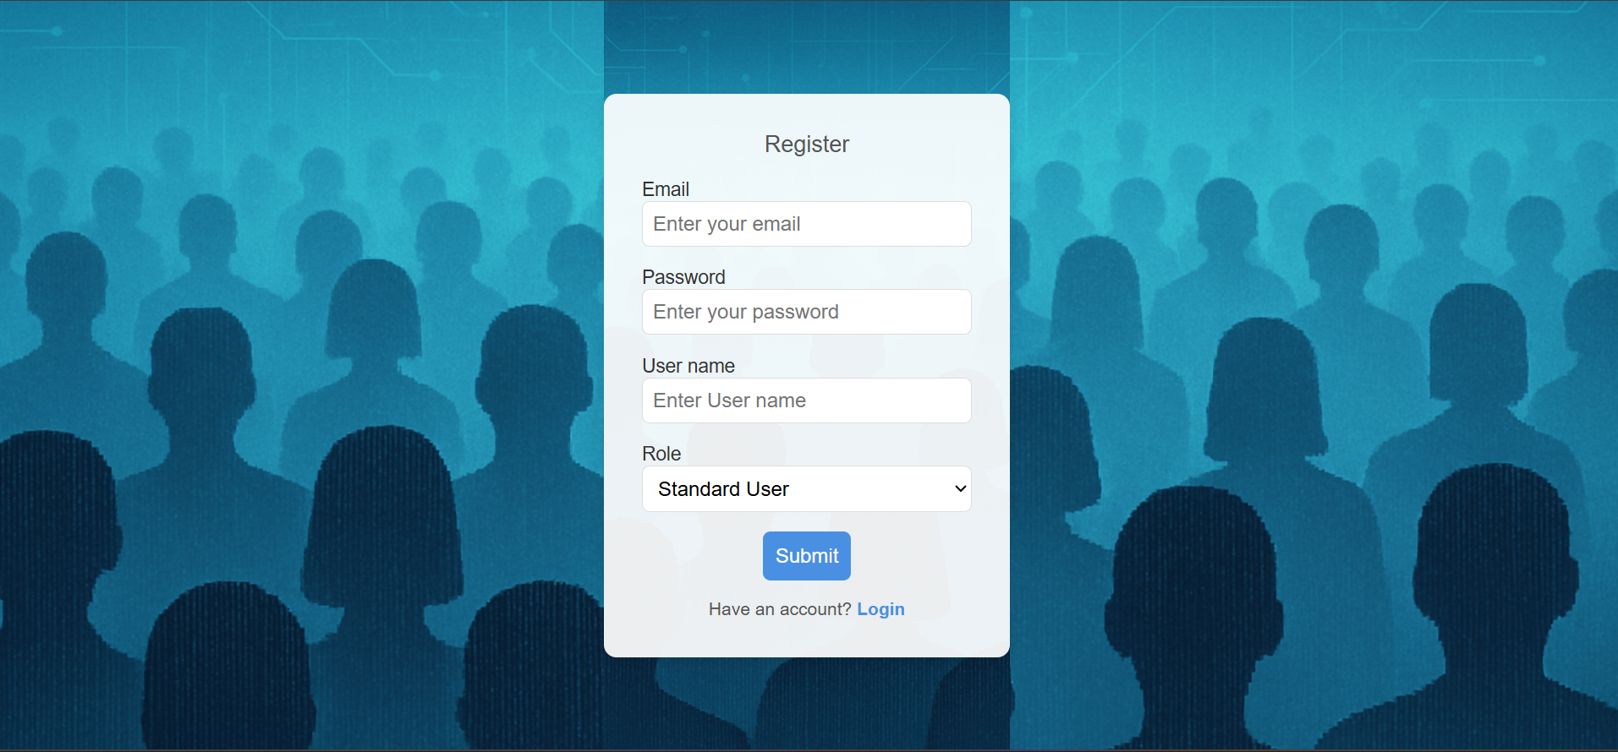

Outputs of milestone-1
1.Login Page
2.Registration Page

Slide 14
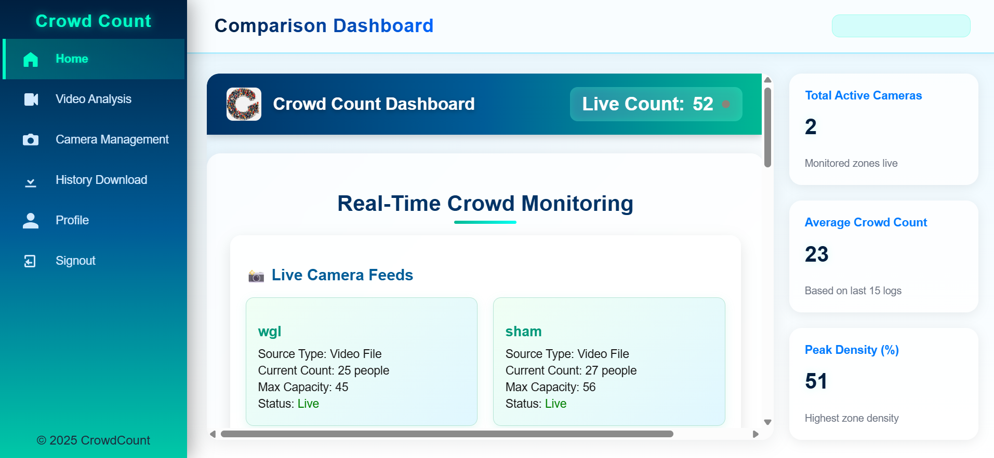
Outputs of milestone-1
3.Dashboard

Slide 15
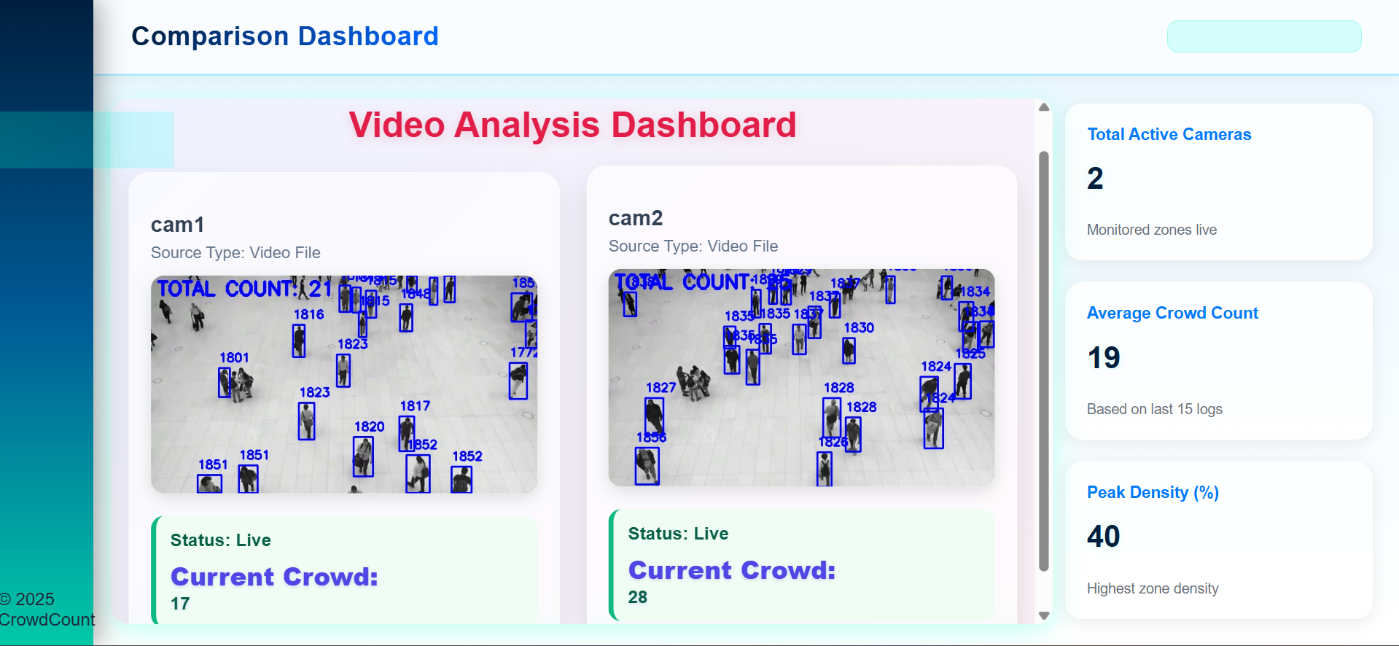
Outputs of milestone-2
1.Uplaod Video

Slide 16
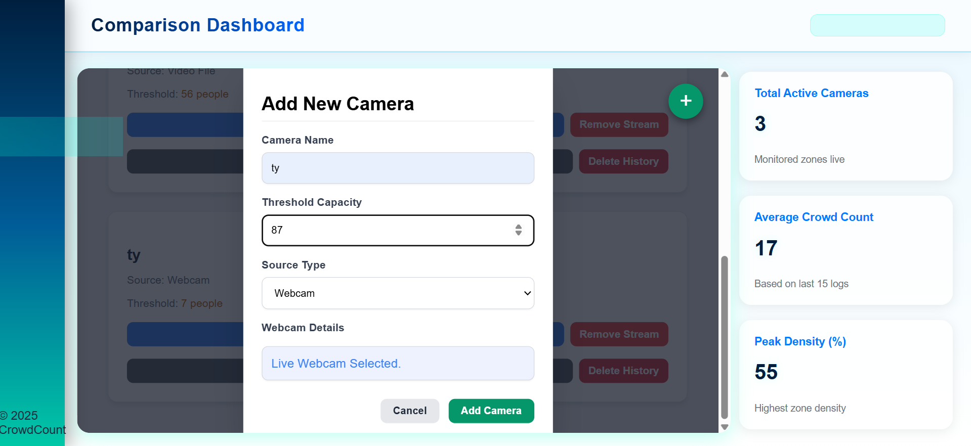
Outputs of milestone-2
2.Live webcam

Slide 17
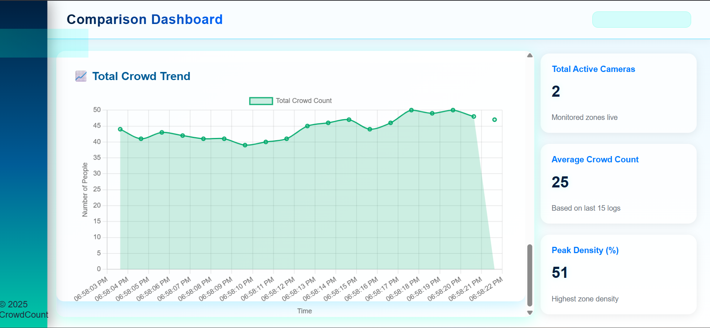
Outputs of milestone-3
People Count in Line chart

Slide 18
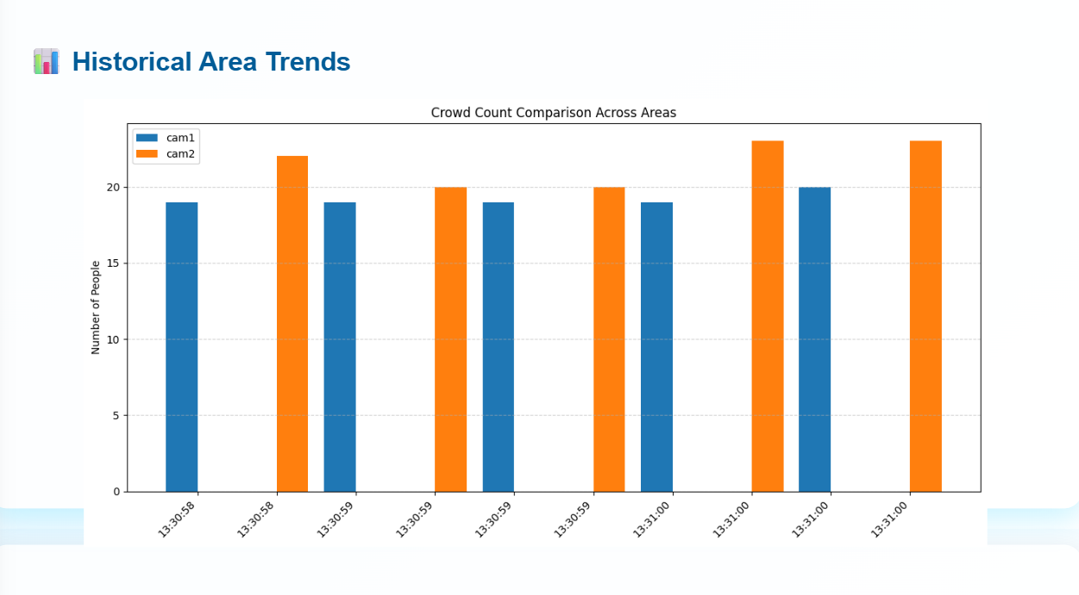
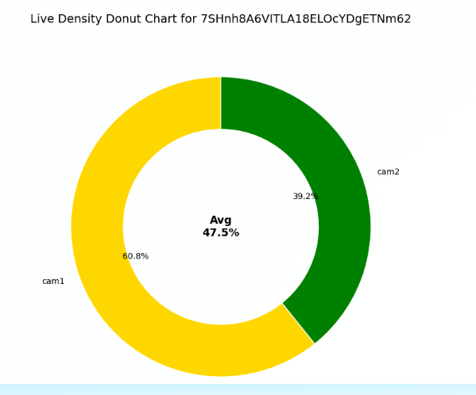
Outputs of milestone-3
Zone Occupancy in Barchart
Density View in Pie chart

Slide 19
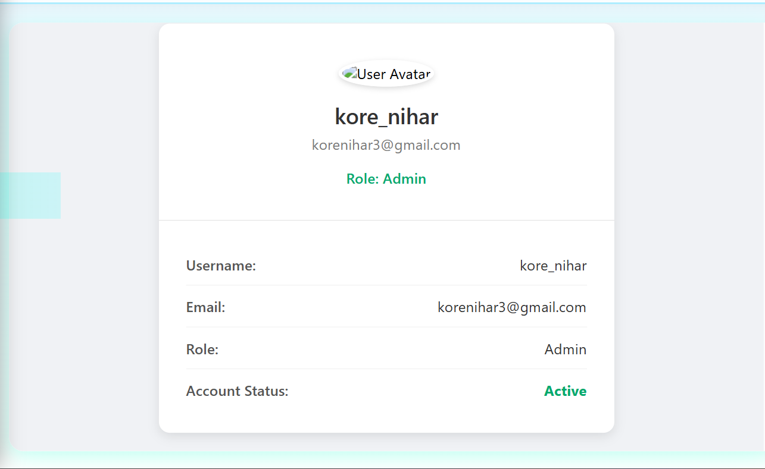
Outputs of milestone-4
Admin Panel
The admin panel allows authorized users to manage cameras, define Restricted zones, set capacity thresholds, monitor live analytics, manage users, and access historical logs. It provides complete control over configuration, alerts, and system operations for efficient crowd monitoring.
Profile

Slide 20
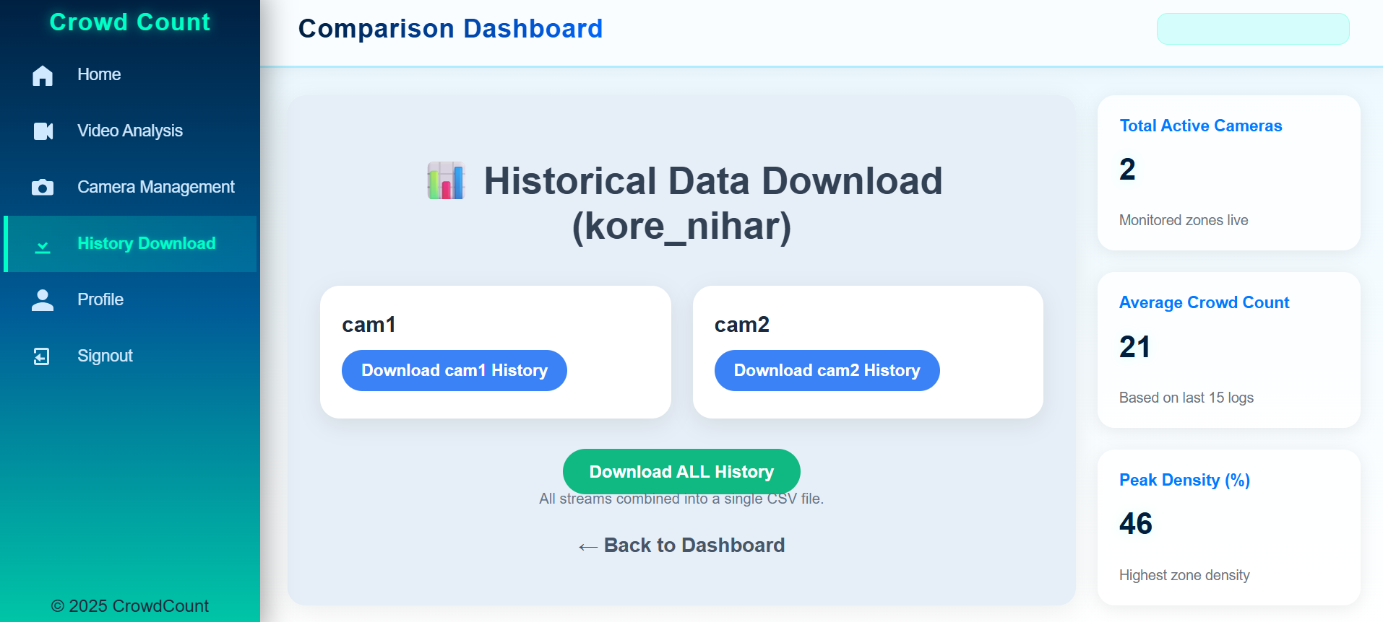
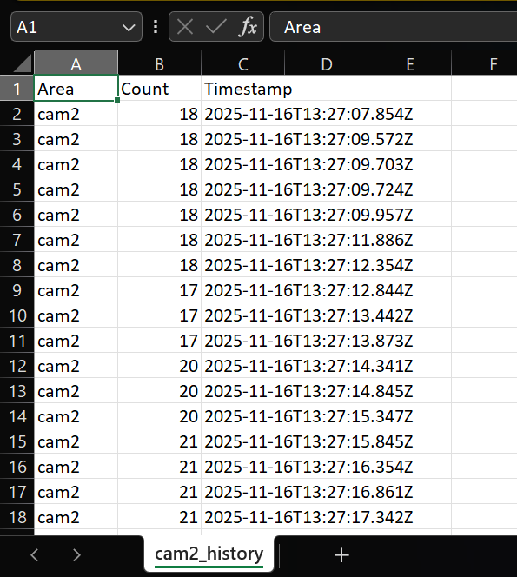
Outputs of milestone-4
History Download

Slide 21
Steps to operate website
Step 1: Sign In
Open the website.
Enter your registered email and password.
Click Sign In.
If you don’t have an account, choose Register to create one.

Slide 22
Steps to operate website
Step 2: Home Dashboard
After login, you will see:
Total active cameras
Live crowd count
Peak density
Recent charts
List of zones/cameras
This gives a quick summary of all monitoring areas.

Slide 23
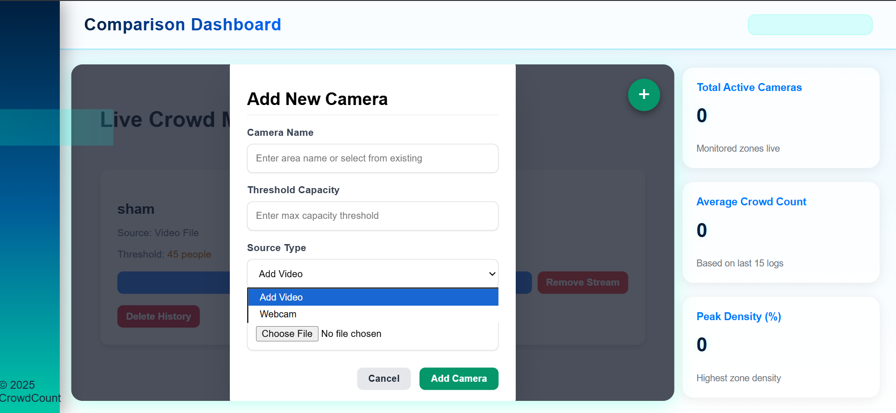
Steps to operate website
Step 3: Start a Camera Stream (Admin Only)
Admins can start video processing by:
Going to Camera Management page
Choosing:
Upload Video OR
Start Webcam
Enter an Area Name
Set a Capacity Threshold
Click Start Stream
The system begins live detection automatically.

Slide 24
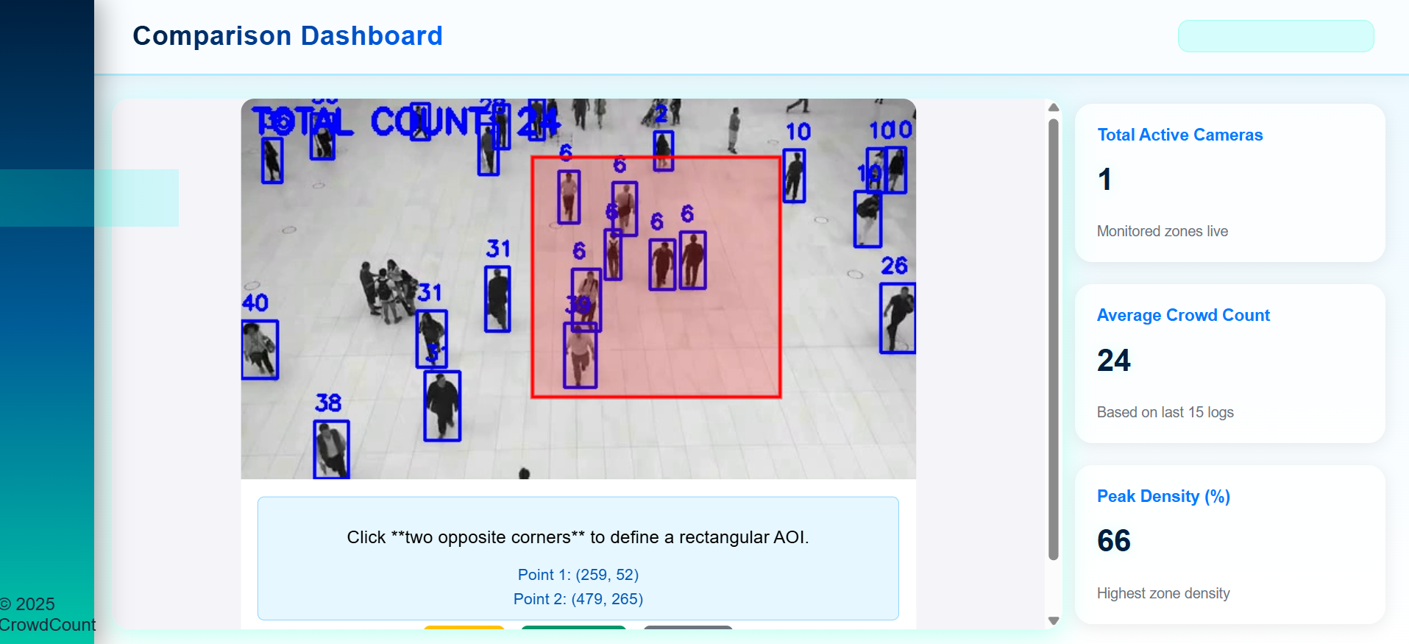
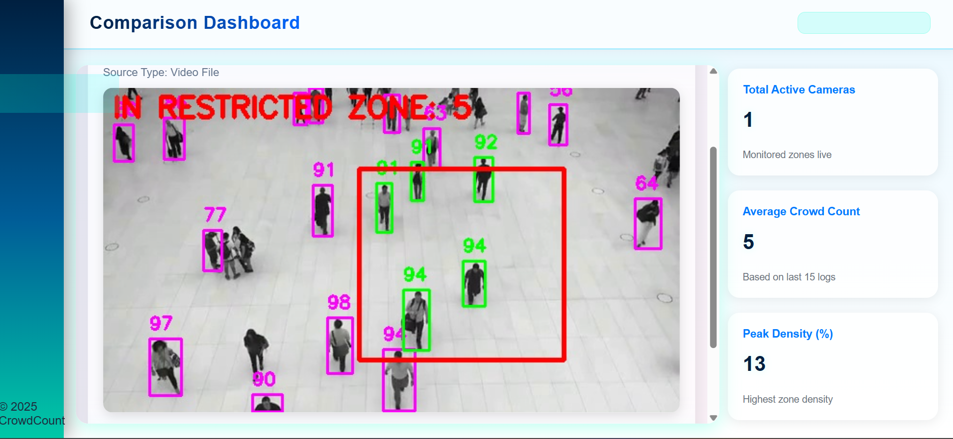
Steps to operate website
Step 4: Define Restricted Zone (AOI)
(Admin Feature)
Go to Define AOI
Drag a rectangle on the video feed
This creates a restricted area that counts only people inside it
Click Save AOI
System will start showing:
"INSIDE RESTRICTED ZONE: X"

Slide 25
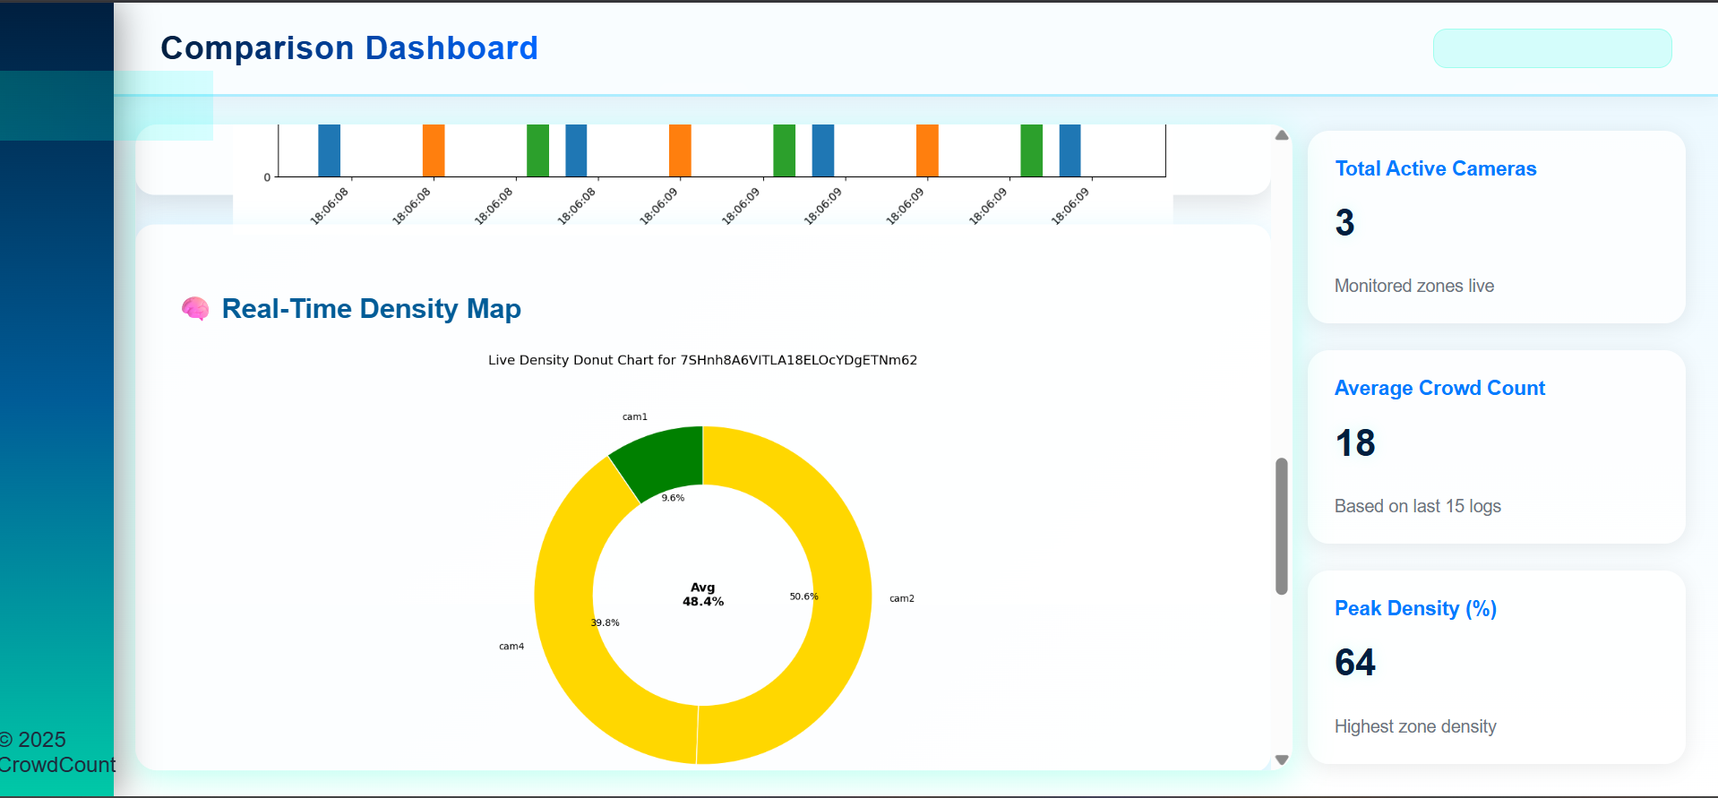
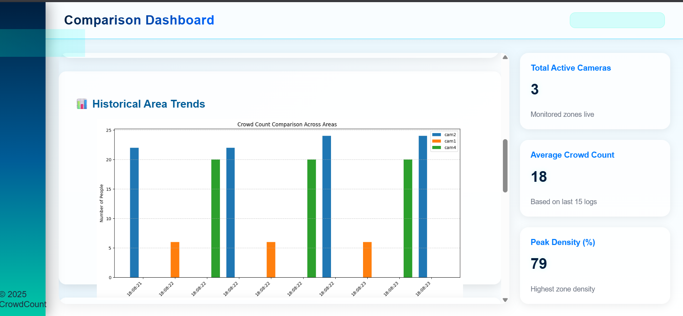
Steps to operate website
Step 5: View Live Video & Count
Open home tab
Watch the live feed
Person boxes, IDs, and AOI are drawn on the screen
Live count updates every second
Density colors:
Green → Normal
Yellow → Warning
Red → Overcrowded

Slide 26
Steps to operate website
Step 6: Check Historical Data
Go to History Download
Select one area or all areas
Download CSV file
File includes:
Timestamp
Area name
Crowd count
Useful for analysis, reporting, and trends.

Slide 27
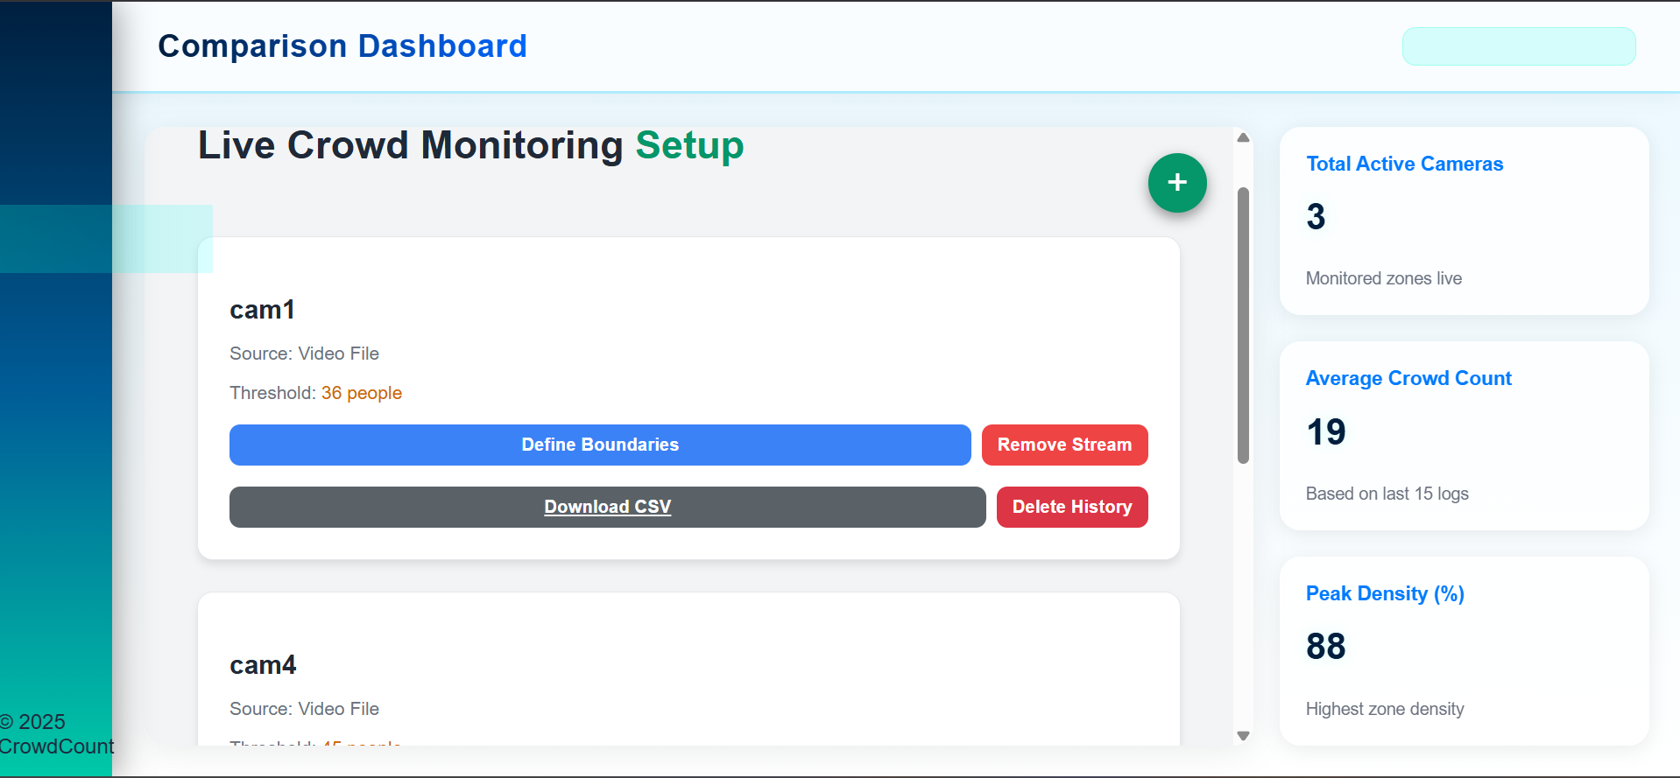
Steps to operate website
Step 7: Stop Streams (Admin Only)
To stop any running camera:
Open Camera Management
Select the camera
Click Stop Stream
Resources get cleared immediately

Slide 28
Future enhancements
Multi-class detection (vehicles, objects)
AI-based overcrowding prediction
Automatic camera calibration for Restricted zone adjustments
Night-vision support using low-light enhancement models.
Multi-class analytics: staff vs visitors vs objects
GPU acceleration for faster model inference
Multi-zone behavior analysis
Predictive staffing suggestions during peak hours

Slide 29
applications
• Shopping malls and retail outlets for monitoring crowd flow • Airports and railway stations for queue management • Corporate offices for occupancy tracking • Event venues and stadiums for visitor flow management • Tourist locations and parks to prevent overcrowding • Emergency evacuation support with real-time movement tracking • Smart city surveillance and public safety monitoring

Slide 30
conclusion
This project provides an efficient and scalable solution for real-time crowd monitoring using YOLOv8, OpenCV, and Flask. It enhances safety, improves operational decisions, and enables zone-based analytics through an intuitive dashboard.
With advanced admin controls, secure authentication, and exportable reports, the system adapts well to real-world public environments. Future enhancements such as predictive analytics, IoT integration, and mobile alerts will further strengthen its capabilities.

Slide 31


